Slide 1
MEDB 5510 Clinical Research Methods
Week 14
Writing a Research Proposal
Writing up a Research Project
Notes:
Homework

Slide 2
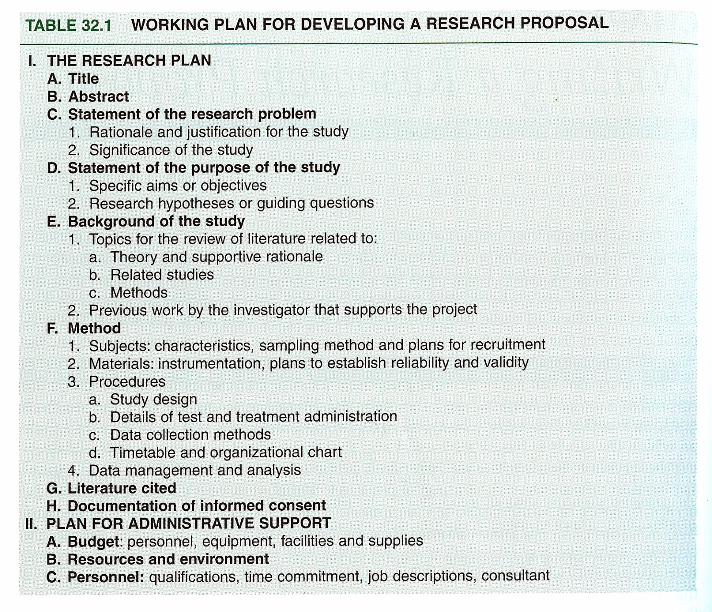
Research Proposal
Portney & Watkins, 2009

Slide 3
Research Proposal
Components
Title
Abstract
Body of proposal
Statement of the problem
Purpose, Hypotheses, and Specific Aims
Background

Slide 4
Research Proposal
Components
Methods
Subjects
Materials
Procedures
Data Analysis
References
Informed consent plans

Slide 5
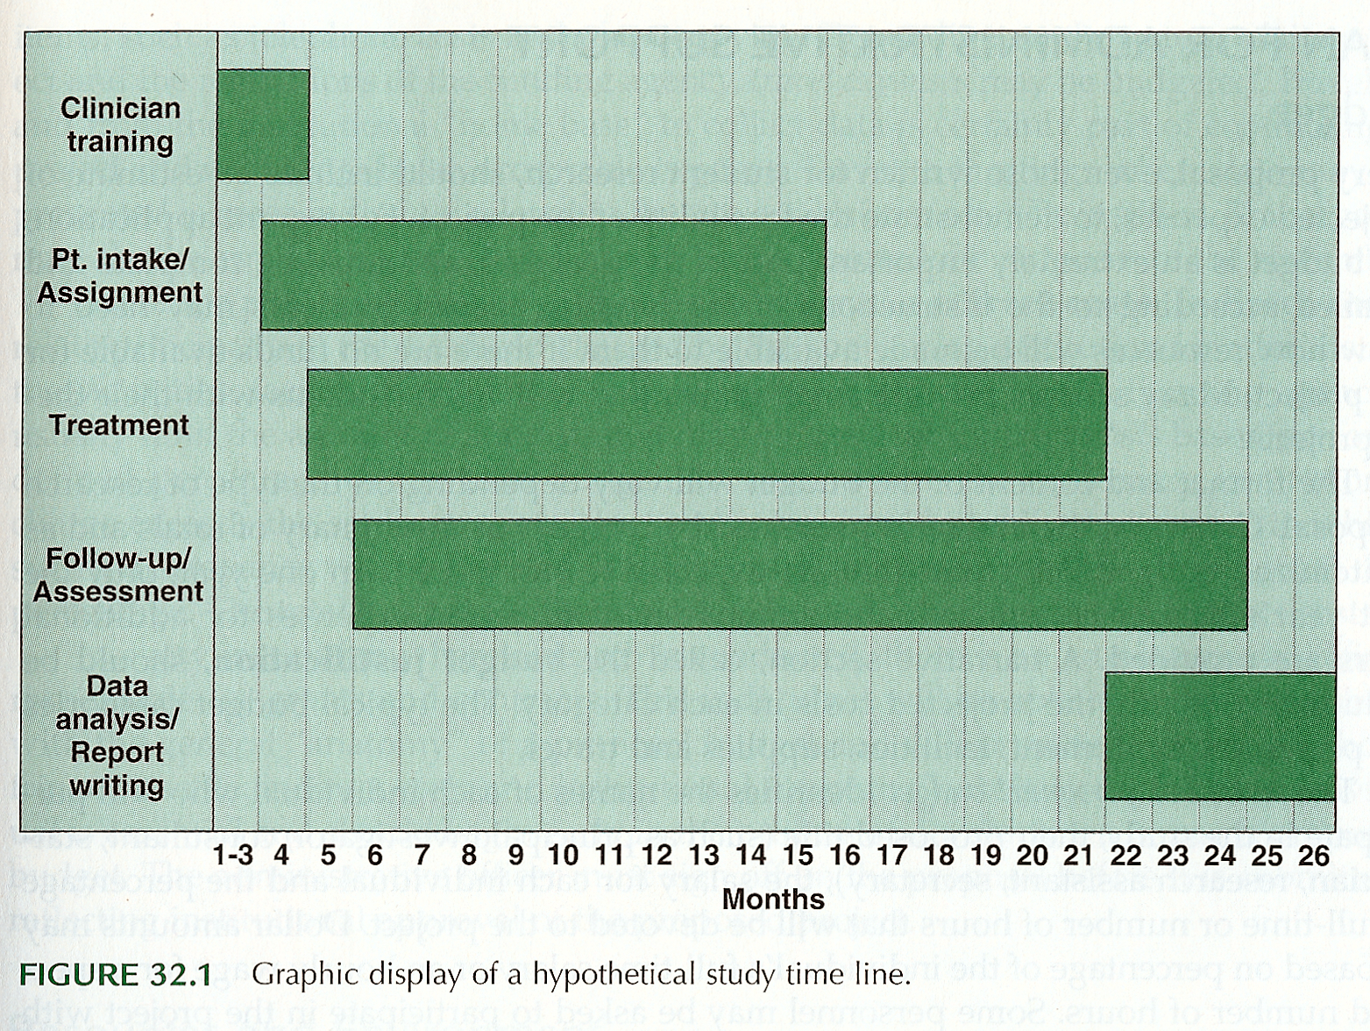
Research Proposal
Portney & Watkins, 2009

Slide 6
Research Proposal
Examples of proposal material
Timeline
Protocol Schedule
Measures

Slide 7
Research Proposal
Administrative Support
Budget - #s and justification
Resources and environment
Personnel
Proposal presentation style
Format – rules and suggestions

Slide 8
Research Proposal
Examples – Other funding mechanisms
National Science Foundation
CDC
Other government agencies
Foundations
Internal funding mechanisms

Slide 9
Writing Style
Proposal – “forward-looking document”
Tense
Statement of problem (present tense)
Background (past tense)
Method (future tense)
Format – varies
Tone
Positive, persuasive, scholarly

Slide 10
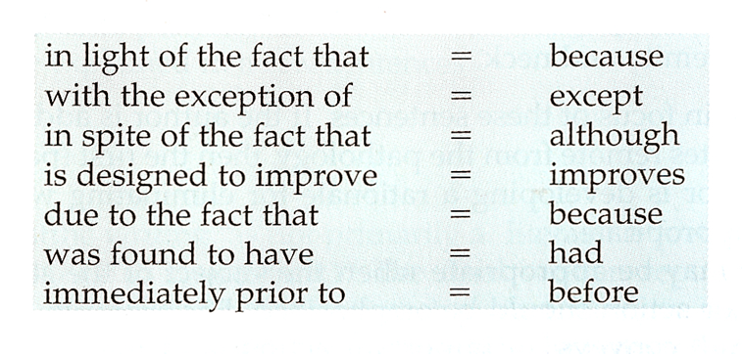
Writing Style
Report – “exercise in organization and clarity of expression”
Specifics
People first
Active vs passive voice
Simplicity of language

Slide 11
Reporting Clinical Research
Journal article
Selecting journal
Preparing the submission
Structure and content (P & W, Table 33.1)

Slide 12
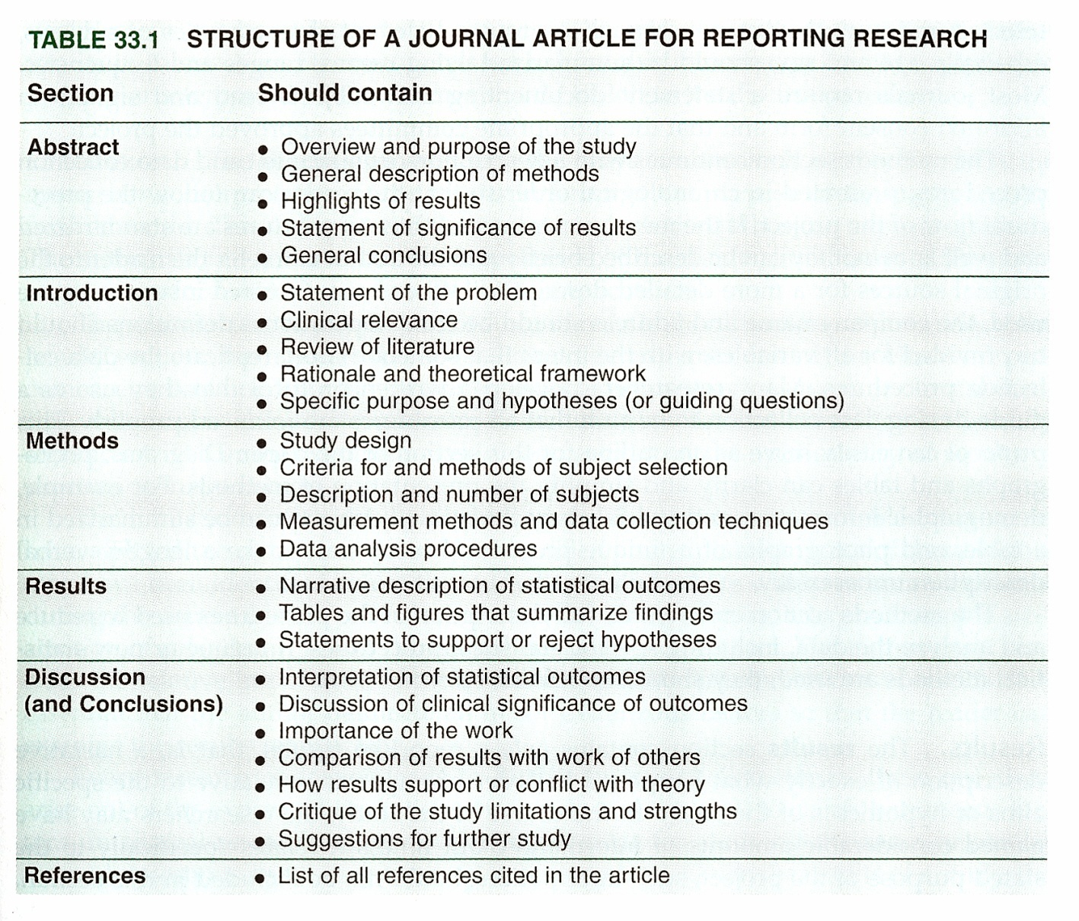
Reporting Clinical Research
Portney & Watkins, 2009

Slide 13
Reporting Clinical Research
Journal article
Preparing the submission
Structure and content (Table 33.1)
Tables and graphs
Publishing thesis and/or dissertation

Slide 14
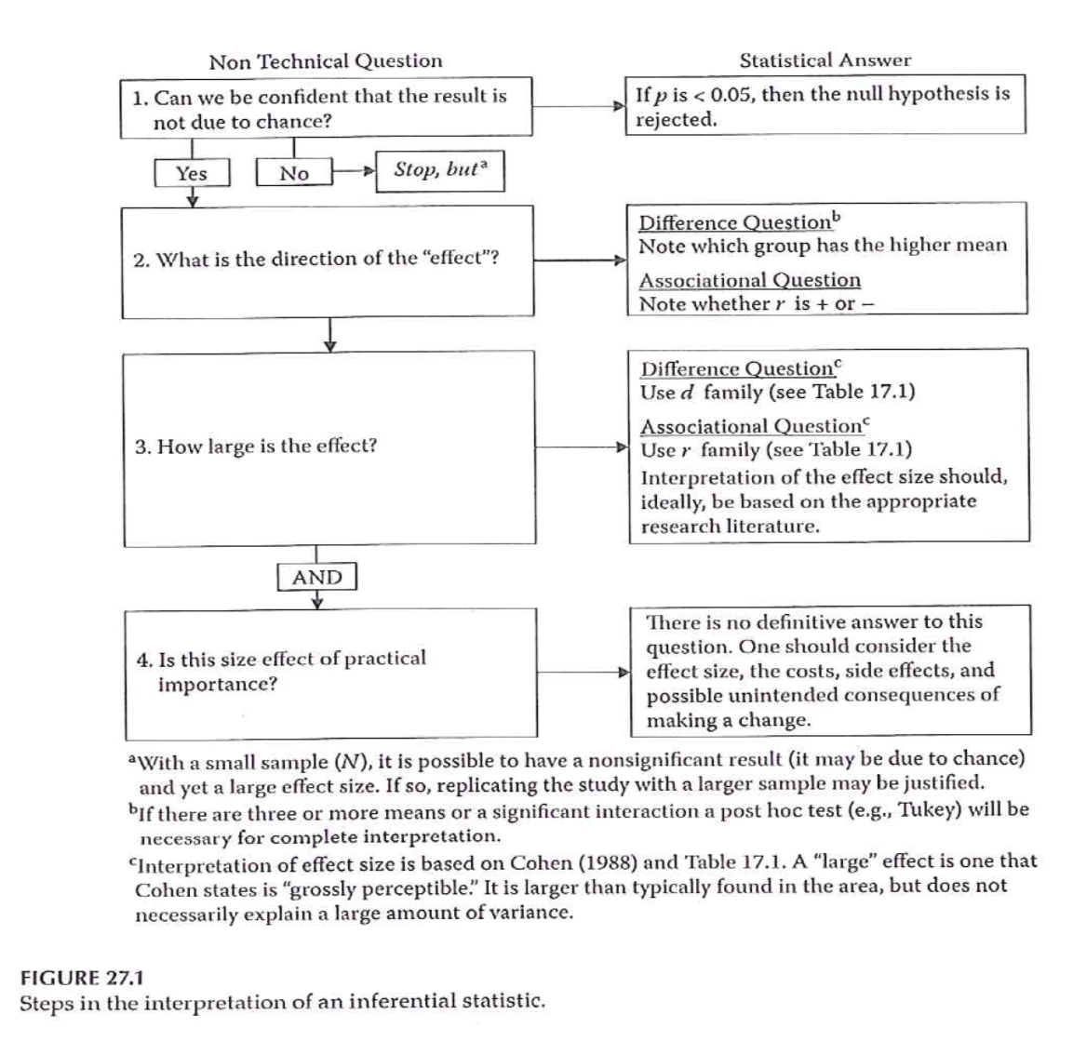
Reporting Clinical Research

Slide 15

Reporting Clinical Research

Slide 16
Reporting Clinical Research
Poster presentation
Content and layout
Materials

Slide 17
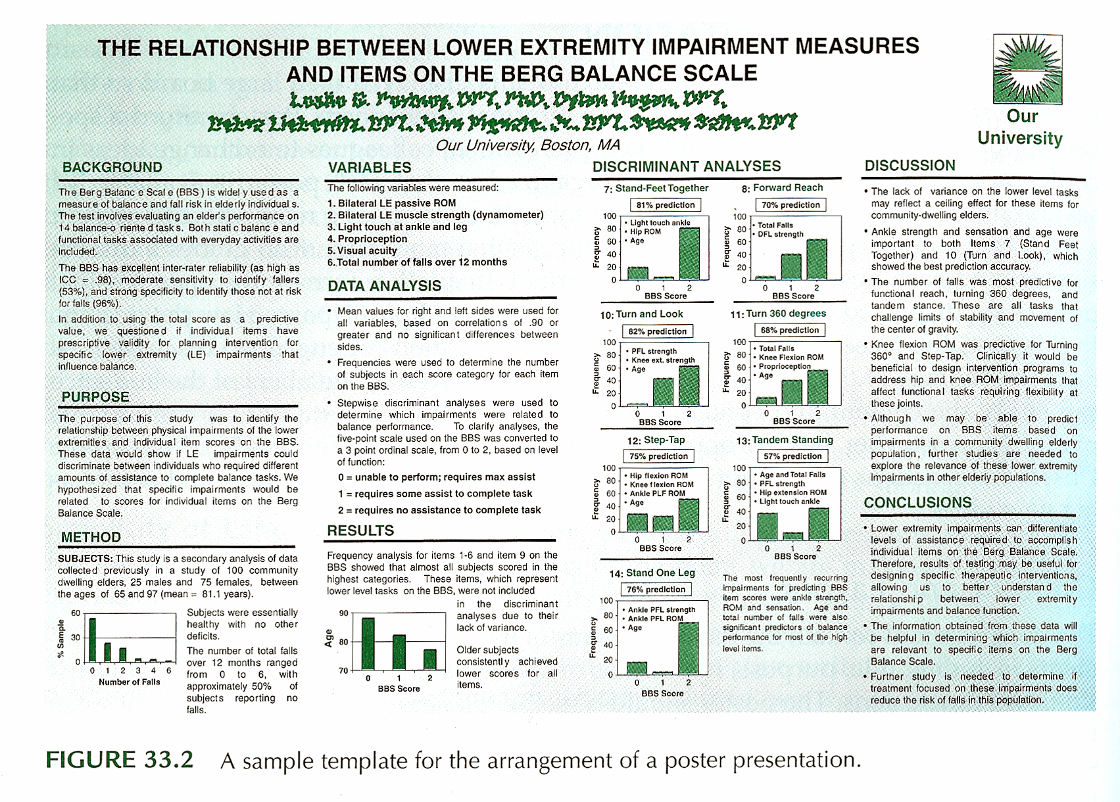
Reporting Clinical Research
Portney & Watkins, 2009

Slide 18
Reporting Clinical Research
Oral presentation
Planning and preparation
Visual presentation
Types of slides
Limiting words
Contents of slides
Graphics
Backgrounds and colors
Rehearsal

Slide 19
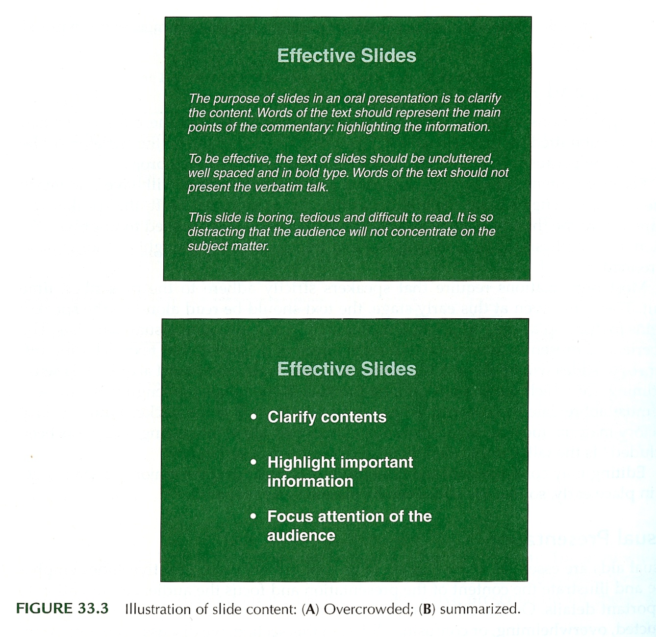
Reporting Clinical Research
Portney & Watkins, 2009

Slide 20
Final Projects
Paper (up to 200 pts)
Class Presentation (up to 40 pts)
Poster (up to 10 pts)
Due dates
Presentation & Poster – last day of class
Section 0002 – Thursday, May 3, 2018
Paper – Finals week
Section 0002 – Tuesday, May 10, 2018

Slide 21
Final Projects
Format – Refer to the grading rubric and information in the Syllabus for web sites with relevant information
Presentation –
Research conference style – Presentation then discussion
Time: 10-min presentation
Structure: Objectives, Background, Methods, Planned analyses, Implications
Prepare “slides” for visual support

Slide 22
Final Projects
Poster –
Overlap between poster material and presentation visual material
Submit poster material as a PowerPoint file (.ppt or .pptx)
Due on the day of presentations

Slide 23
Final Projects
Written Research Proposal
Turn in through Turnitin link on the course Blackboard site by 5pm on the due date
Structure – Refer to the grading rubric; truncated version of the five-chapter thesis format
Introduction to the problem (Chapter 1)
Review of the literature (Chapter 2)
Description of methodology (Chapter 3)
Proposed implications of the study
References

Slide 24
Final Projects
Written Research Proposal
Title –
First chance to get reader’s attention
Brief, but descriptive
Abstract –
Next chance to get reader’s attention
Publication - May be the only part of the article read by most
Proposal – needs to present a summary of the proposed study

Slide 25
Final Projects
Written Research Proposal
Introduction – (approx. 1-2 pages)
Introduce the topic / Frame the problem – convince reader that there is a significant issue/concern that needs to be addressed. “Critical need” “So what?”
How your proposed project will address the “critical need”
Aims / goals / objectives of proposed study
Expectations / Impact of findings

Slide 26
Final Projects
Written Research Proposal
Review of the Literature –
Organized to support what you want to do
NOT an annotated bibliography
Represents your understanding of the relevant literature
Provides background to justify your proposed study
Final section -
Gaps in the literature – what needs to be done
How your proposed study will address those gaps
Describe your research hypotheses / questions

Slide 27
Final Projects
Written Research Proposal
Review of the Literature –
What a literature review is NOT –
Annotated bibliography
Must represent your own words and thoughts –
Reminder of what constitutes plagiarism

Slide 28
Final Projects
Written Research Proposal
Methods
Study design –
Description of the overall study design - how you are going to do your study
Sample –
Description of who is being studied
Where did they come from?
Sampling method
Inclusion and exclusion criteria
Power analysis information could be included here

Slide 29
Final Projects
Written Research Proposal
Methods
Measures –
Describe all the measures that will be obtained/used in the study
If using established scales/measures, provide reference and general description of values that will be obtained
If using measures developed for the study, provide more detail
Will there be pilot testing of the measure?
Organize information about measures –
Outcome measures
Independent variables
Other measures

Slide 30
Final Projects
Written Research Proposal
Methods
Procedures –
Description of how the study will be conducted
How participants recruited and enrolled
Consenting process
Random assignment described if appropriate
Timing information
Length of intervention
Timing of measurements
Length of follow-up
Description of groups / interventions
Compensation / payment if appropriate

Slide 31
Final Projects
Written Research Proposal
Methods
Statistical analysis
Data management and quality checks
Descriptive analysis
Analyses to test hypotheses / questions
Description of analyses should clearly relate to each hypothesis / question
Implications of your study
What will be the impact of your study?
What could be the next step after this study?

Slide 32
Assignment
Work on your final projects –
Oral presentation
Poster material
Written proposal

